Slide 1
Golden Gate ASHRAE Kick-off
September 12, 2018

Slide 2
Agenda
Intro to our Chapter- Michelle- 10 min
Committee Meet & Greet – 75 min
ASHRAE Overview- Alyse- 25 min
Closing- Q&A- 10 min

Slide 3
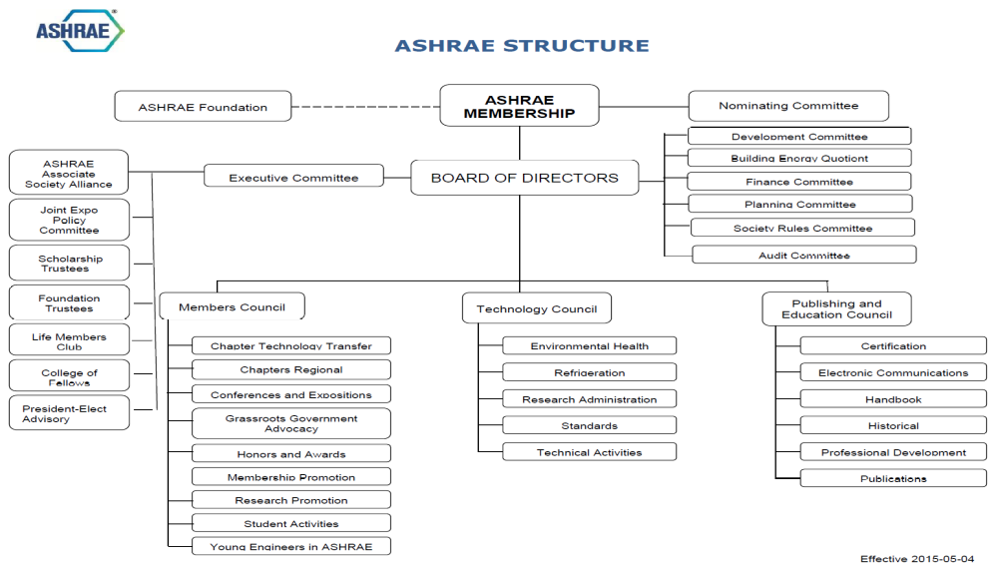

Slide 4
Golden Gate Board of Governors
Michelle Dionello- President
Jason Lesser- President-Elect
Alyse Falconer- Secretary
Brian Chacon- Treasurer
Jeremy Martinez- 2nd year
John Gardner- 1st year
Nikola Kravik- Past President

Slide 5


Slide 6
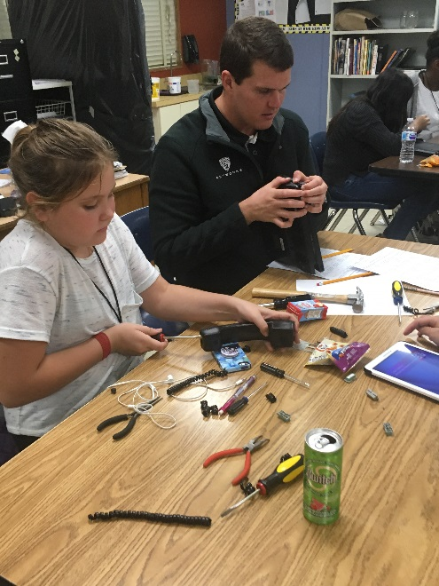
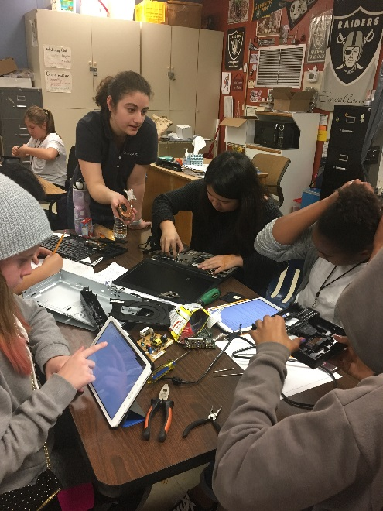

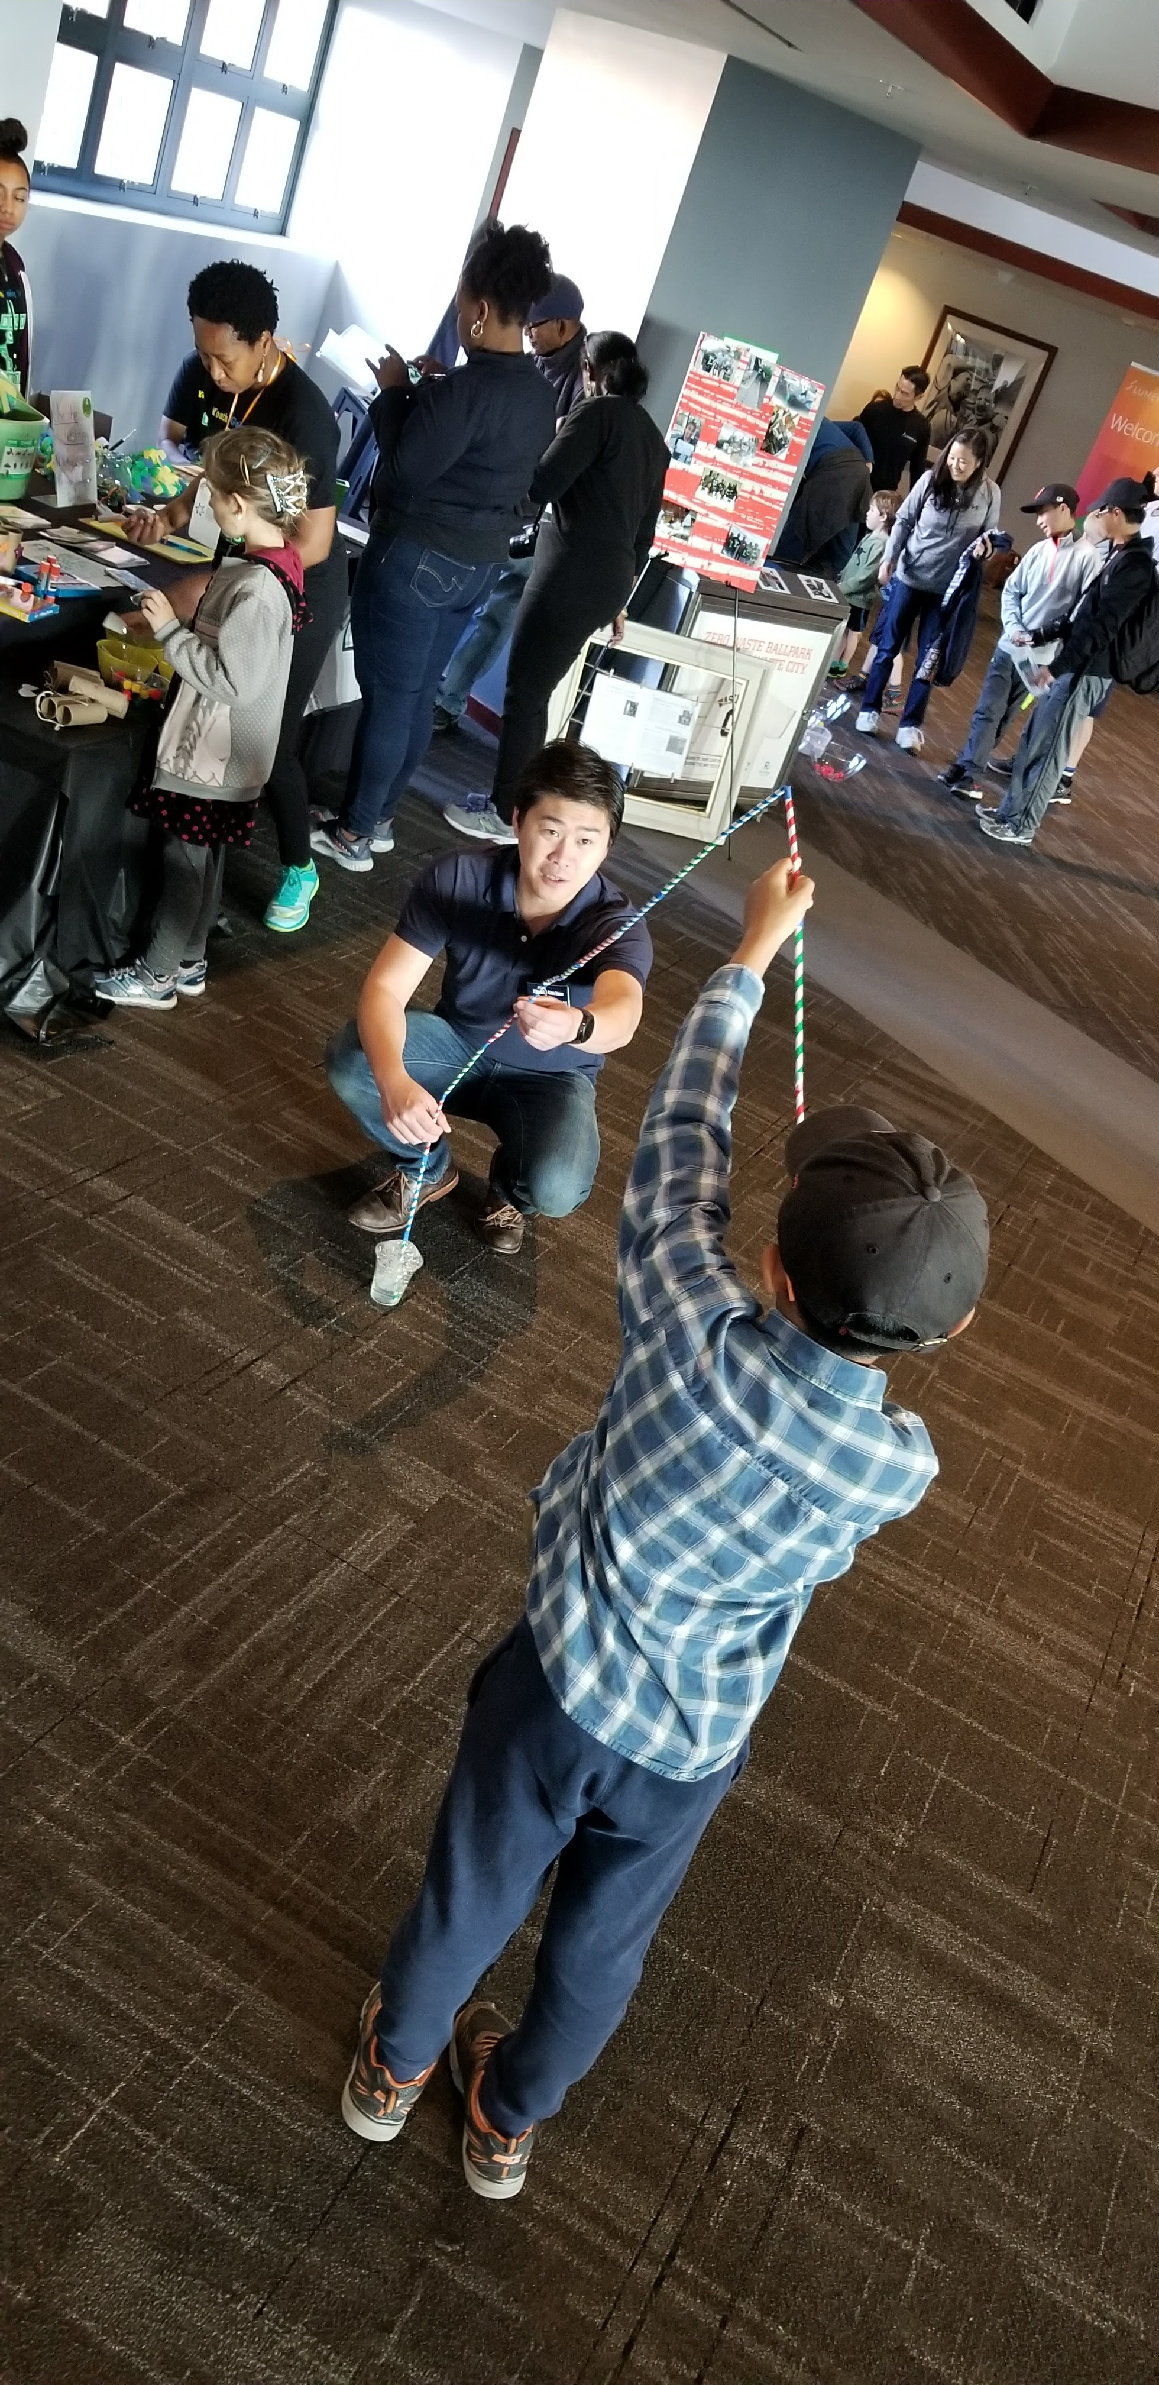
2017-2018 Student Activities
Bay Area Science Festival
K-12 STEM Full Circle
Partnerships with other schools in Bay Area
San Francisco State Student Chapter Re-started!

Slide 7
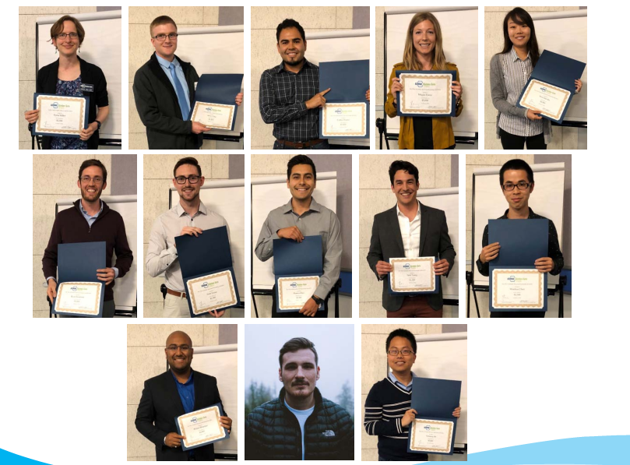
$39,000 in Scholarships

Slide 8
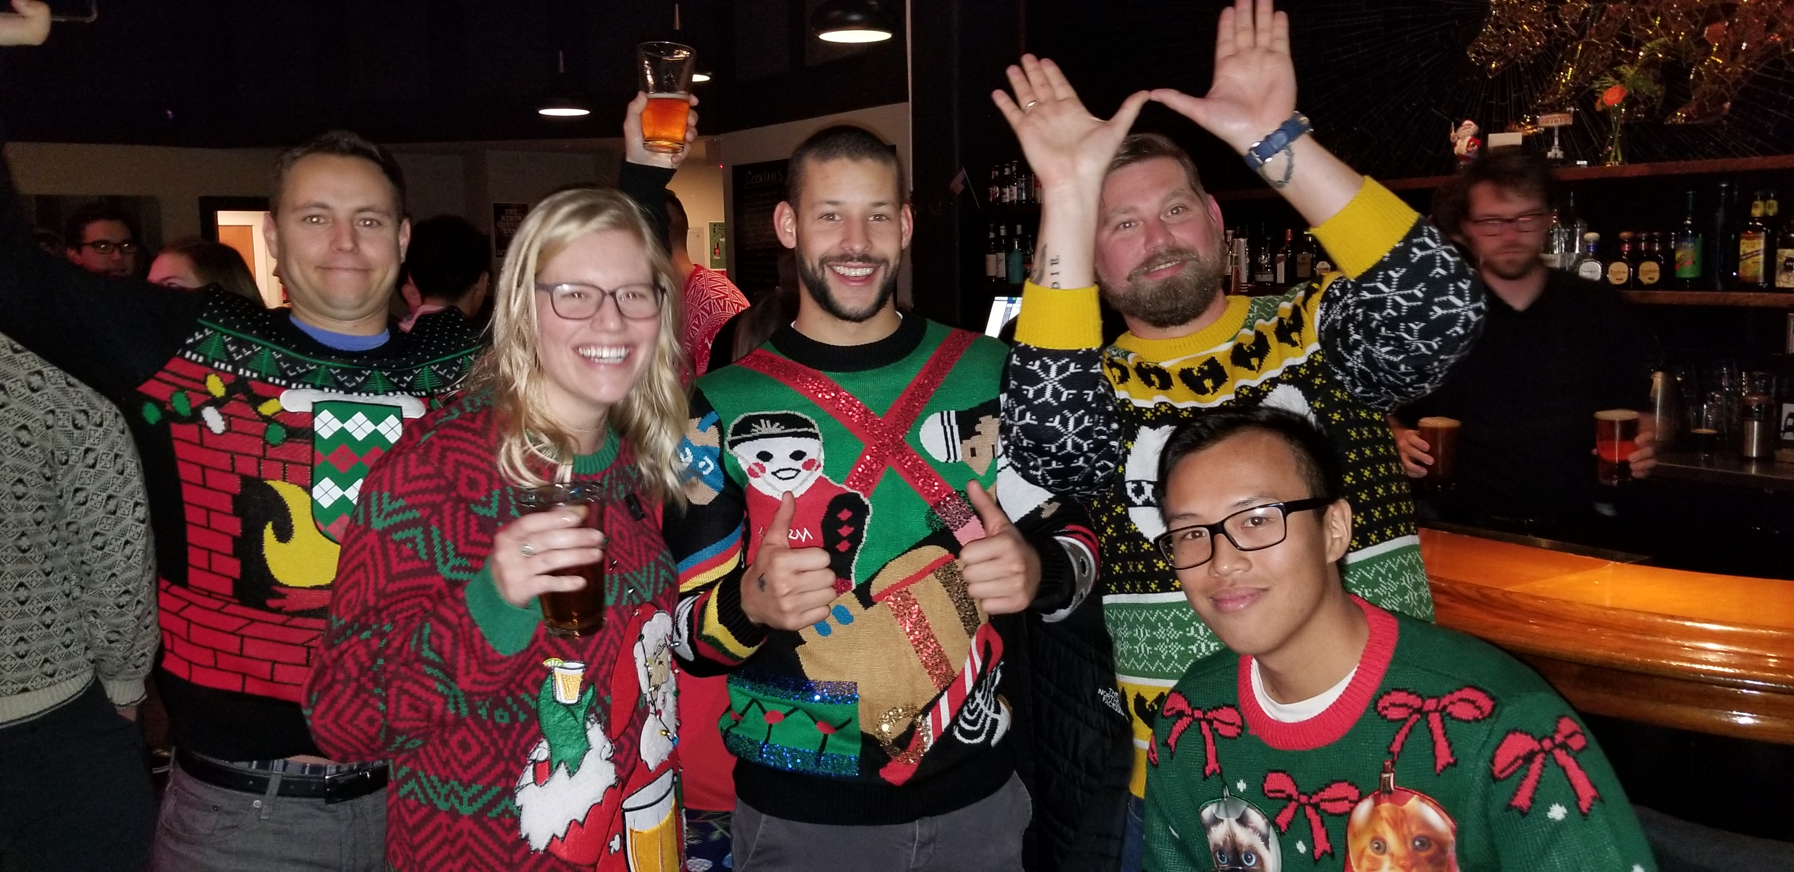
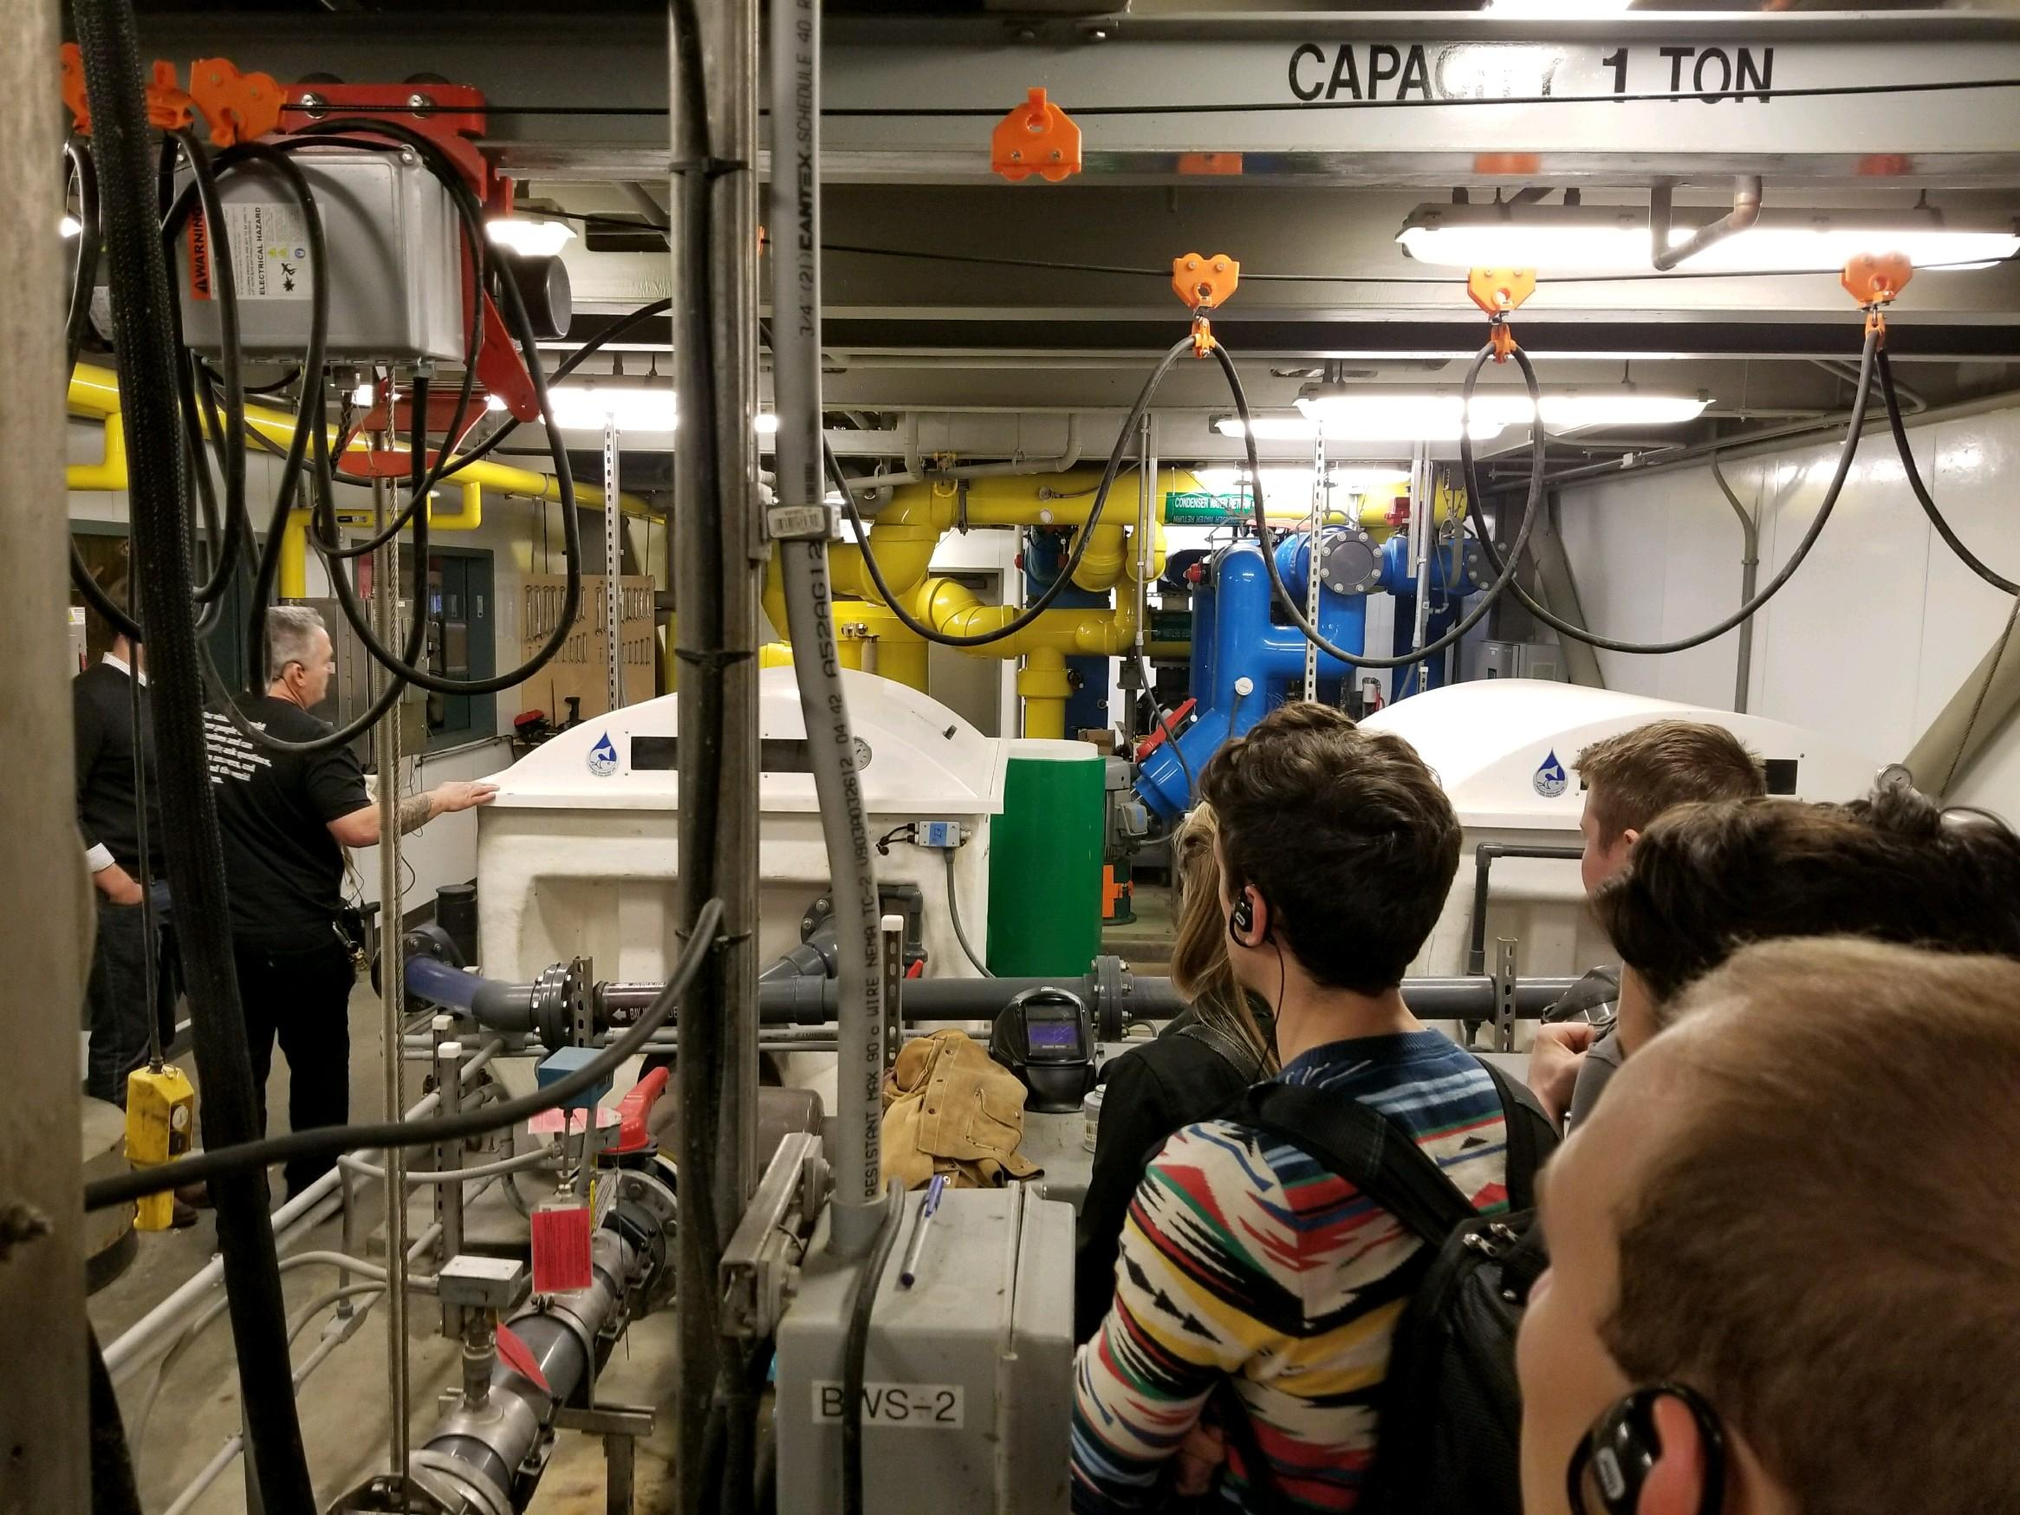
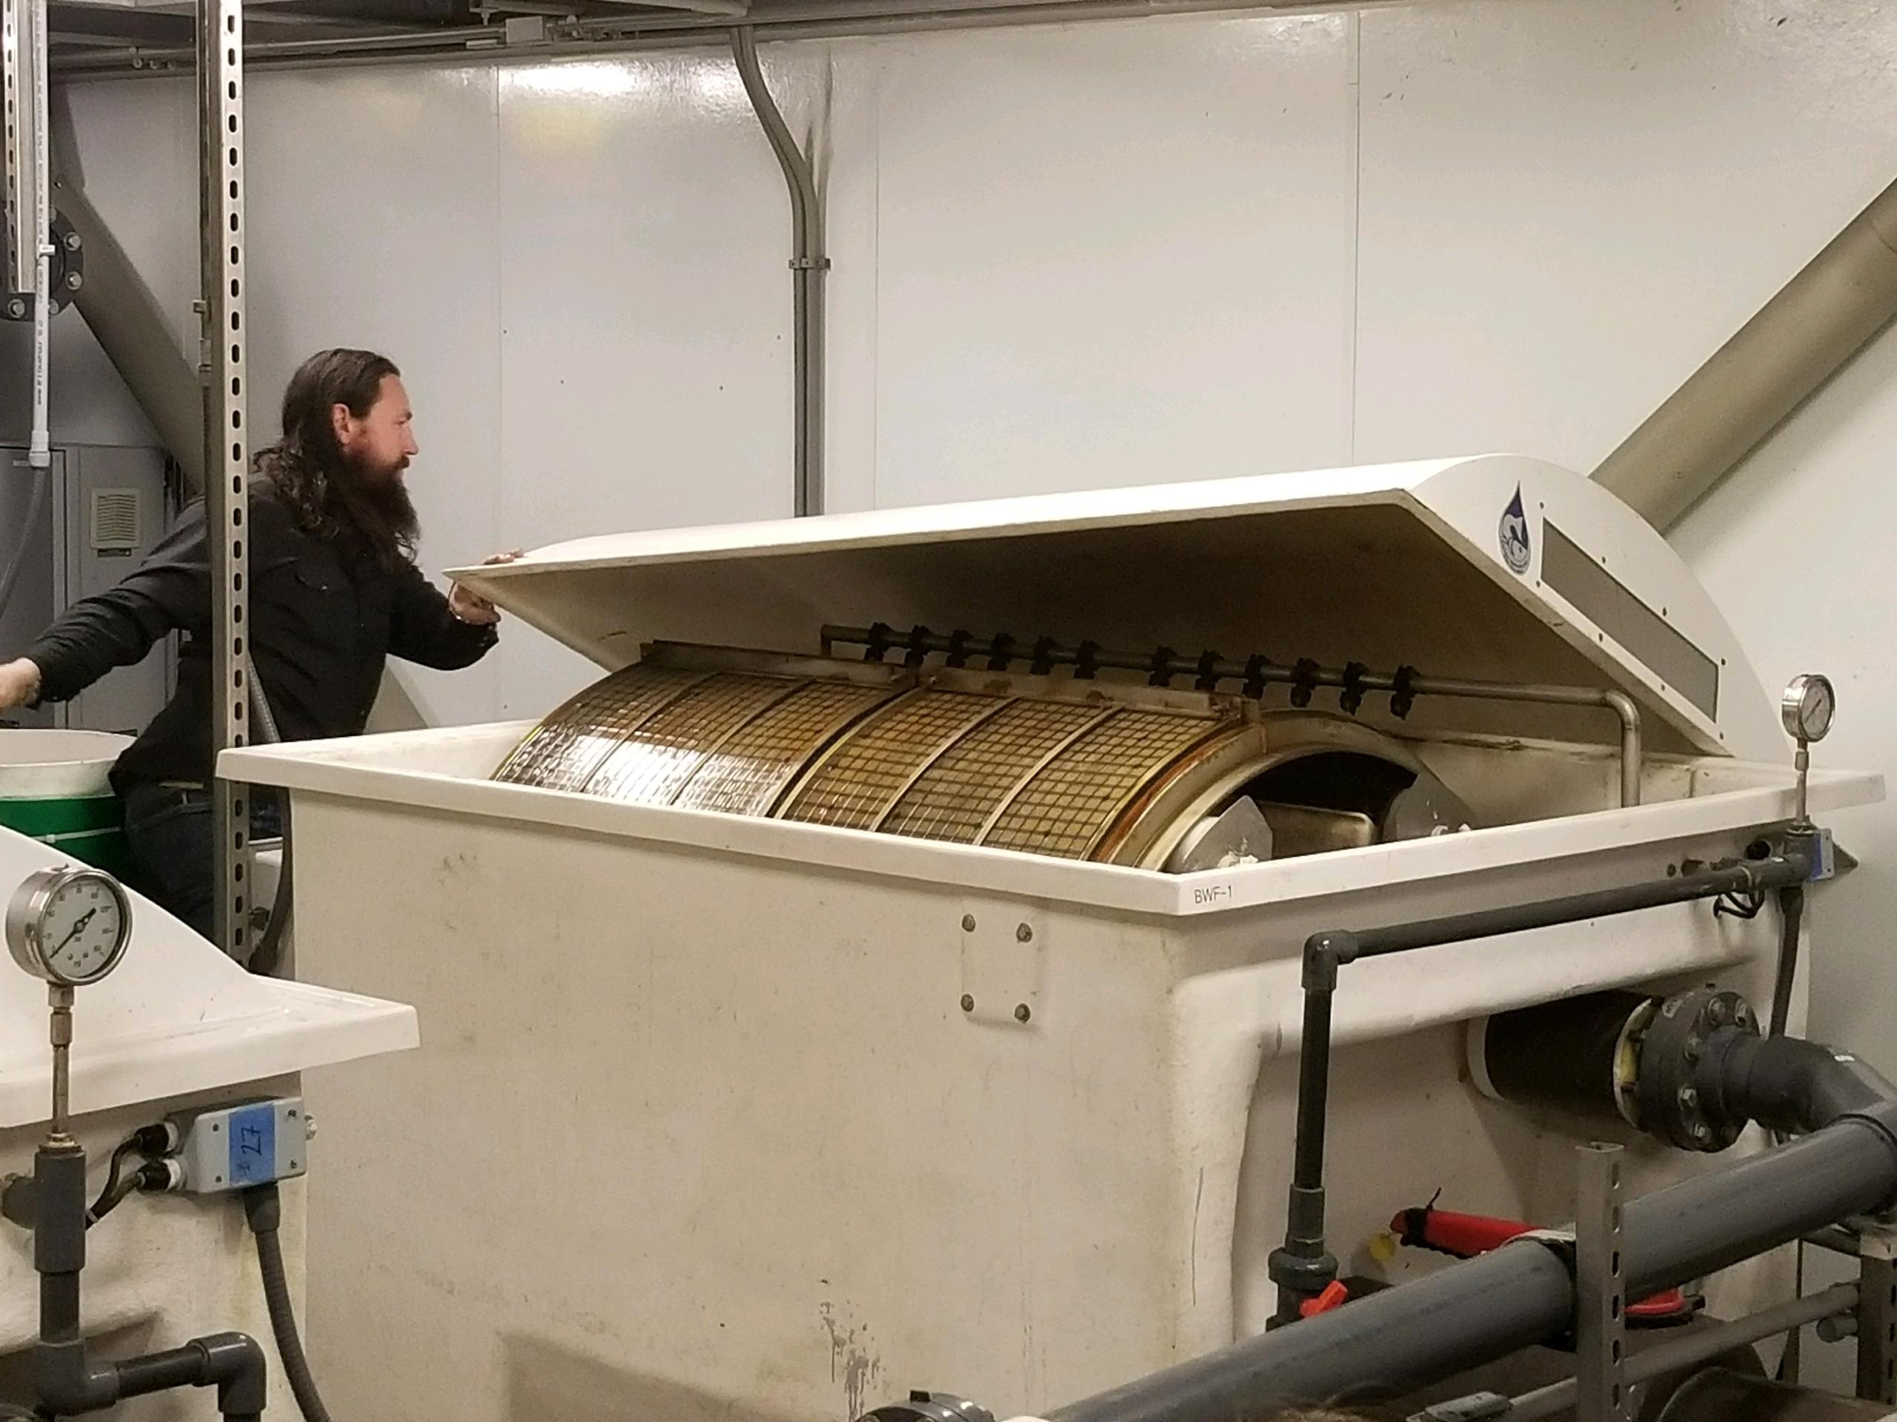
YEA- Social and Tech Tours

Slide 9
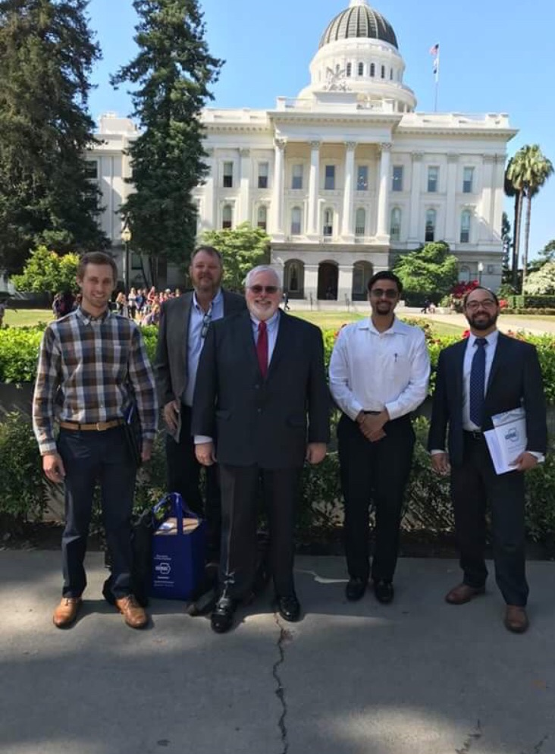
Government Affairs-Day on the Hill

Slide 10

Other 2017-2018 Highlights
Met growth goal- 18 new members!
Met our RP goal- $25,000!
1st Place Tech Awards at Region
  Other Institutional- Existing
    Eric Solrain (Integral Group)
  Educational Facilities- New
    Stet Sanborn (Smith Group)
  Commercial Buildings- Existing
    John Andary (Integral Group)
  Commercial Buildings-NEW
    Steve Gross (Interface Eng)

Slide 11


Slide 12

Golden Gate Committees
Membership Promotion-> Brian Chacon
Young Engineers of ASHRAE-> Jake Barker
Student Activities-> Juliana Velez, Matt Flannery, Alicia Tan, Richard Pallion
Research Promotion-> Charlie Warren
Chapter Technology Transfer-> Zeid Arnaout
Government Affairs-> Jeremy Martinez
Historical-> Tom Gilbertson
Refrigeration-> Ken Mozek
Electronics Communication Chair-> Moana Reynau
Publicity-> Billy Martin
Golf-> John Gardner/ Brian Chacon
Seminar -> Glenn Friedman, Tyler Bradshaw, Ted Tiffany, Clark Bisel, Bill Burke, Charles Eley, David Lehrer, Liang Ma
Tennis-> James Gronek
Nominating-> Cory Palmer
Auditing-> Erik Kolderup
Foundation Committee-> Glenn Friedman, Brian Chacon, Richard Pallion, Juliana Velez, Michelle Dionello
Redwood Empire Section-> Billy Martin, Adrian Giovenco, Nikola Kravik, Brian Chacon, Michelle Dionello

Slide 13


GG Committee Recruitments
Sustainability Chair
  Chapter Opportunity Fund
Special Events Committee
  Golf & Tennis Chairs; potentially to do other- picnic, dances, etc?
Women in ASHRAE (WiA)
Product Show Chair
  Tech Session Co-Chair

Slide 14
Chapter Meeting Calendar 2018
To be finalized by Oct 1st!!
October 24th – Integration of HVAC and Lighting Control Systems
November 15th - Solving dehumidification problems in the world of low temperature applications for food, beverage, pharma, life science and manufacturing
December 10th – Building our New Energy Future (Joint San Jose Meeting)
January 24th- Safety Code Development for Flammable Refrigerants
Notes:
“Building our new energy future”

Slide 15

My goals for the year
Did you go to ASHRAE last night? It was soooo FUN!
Different types of events
  Lunchtime tech sessions
  Revamping the product show to more EXPO type
  Panel discussion format for some meetings
  Webex and call-in option

Slide 16
Goals continued
Fund a YEA member to attend a Society; Shadow program
Collaborative Chapter Connection
Communication!
  Balance between over communicating and informing
  Volunteer Opportunities

Slide 17


Chapter Regional Conference
August 2019 CRC….
August 2018 Fresno CRC
List of Attendees
  Jason Lesser (Delegate)
  Nikola Kravik (Alternate)
  Jeremey Martinez
  Brian Chacon
  Tom Gilbertson
  Alicia Tan
  Juliana Velez
  John Gardner
  Victor E. Osorio Martinez (Student)
  Alyse Falconer
  Ken Mozek
?
/

Slide 18
Event Tomorrow!!
Kicking Carbon Out of Buildings - How Heat Pumps Will Lead the Decarbonization Revolution
Peter Rumsey, CEO of Point Energy Innovations September 13th @ 6:30pm
Description: California is going through one of its most seismic shifts in building energy policy and design. The move towards full decarbonization of the building stock has started and the policy, technical and financial implications are being developed under our feet. We will share how heat pumps and other forms of electric heating can displace our long time carbon sources of heat. These systems already available and many are cost effective today. Come discuss this shift and how it will impact your building or construction project with one of the industry's leading experts, Peter Rumsey of Point Energy Innovations.Learning

Slide 19

Golf on September 21st

Slide 20

Thank you to our sponsor….

Slide 21
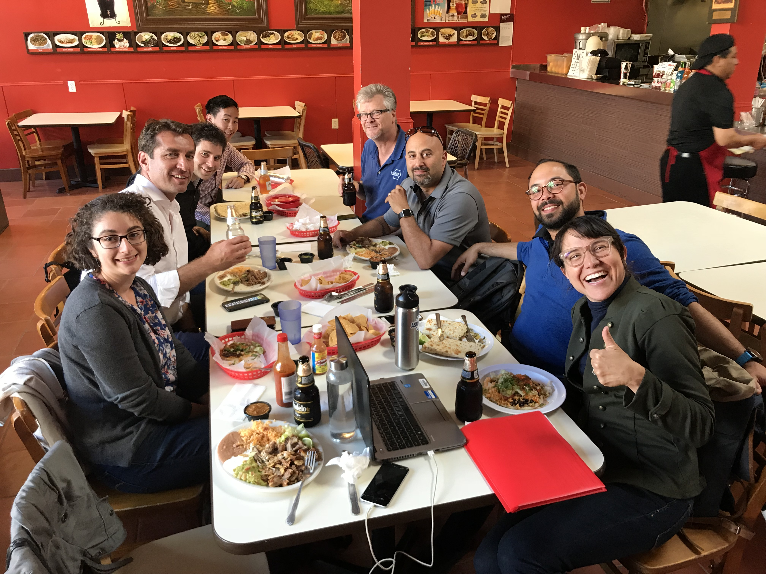
Thank you all for coming….

Slide 22
ASHRAE Mission and Vision
To advance the arts and sciences of heating, ventilating, air conditioning and refrigerating to serve humanity and promote a sustainable world.

